Slide 1




Professor Coleman
Team 6-3

Slide 2


Slide 3

I attended Gordon College and Western Governors University for my Associates, Bachelors, and Masters degrees.
I have been teaching for about 20 years.
If I hadn’t become a teacher, I’d be a veterinarian.
I live in this community, so the success of your student is very important to me!

Slide 4
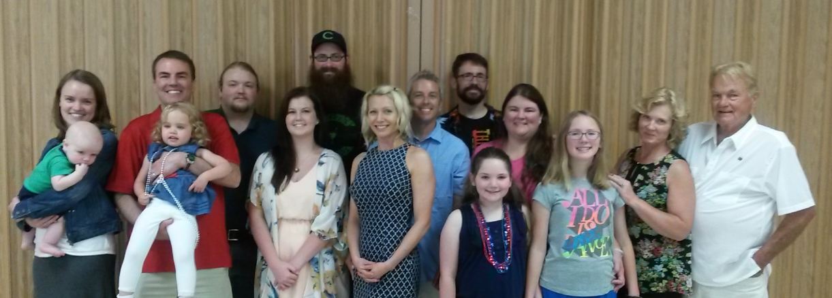
I have been married for 35 years and raised 6 children so there is nothing your student can say or do that I haven’t seen or heard before!

Slide 5


To Prepare the Students promote self management and critical thinking skills.
To help students gain an appreciation of and to connect what they learn in science to real life.
Gain a better understanding of the world around them.
1) Lab safety | 7) Waves/currents/tides
2) Rocks and minerals | 8) Uneven heating/climate/seasons
3) Weathering/erosion/soil | 9) Earth/Moon/Sun
4) Inside the Earth | 10)Astronomy
5) Ocean Floor | 11)Review for EOG/Projects
6) Water cycle and distribution | 12) Life Science preview
Notes:
Astron

Slide 6

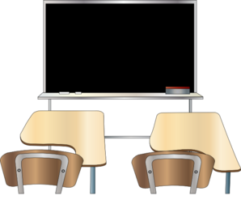
Students will treat their peers, the faculty and staff, and the school equipment with respect, and can expect it in return. No one will be allowed to distract from another’s learning.
⭐No electronic use unless notified.
Come to class on time and prepared in two ways:
With all your materials. Trips to your locker will not be granted on a daily basis.
Focused and ready to learn: ask questions, keep an organized notebook, try your best.

Slide 7



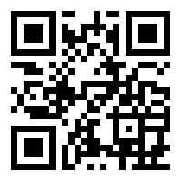
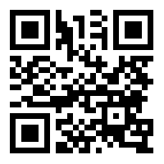
Holt Science and Technology
Georgia Earth Science
If you would like a copy to have at home, send in a flash drive and I will download the entire text book on the flash drive.
Also on LSGA website.
The text book may also be accessed online at
http://my.hrw.com

Slide 8


Slide 9

I will accept late work for a reasonable period of time after the due date, but the work will receive no more than a 70. (70 is better than a 0)
If your student is absent, it is THE STUDENT’S responsibility to find out what was missed and to make missed work. Absent students have 1 day + the number of days missed to turn in assignments.

Slide 10

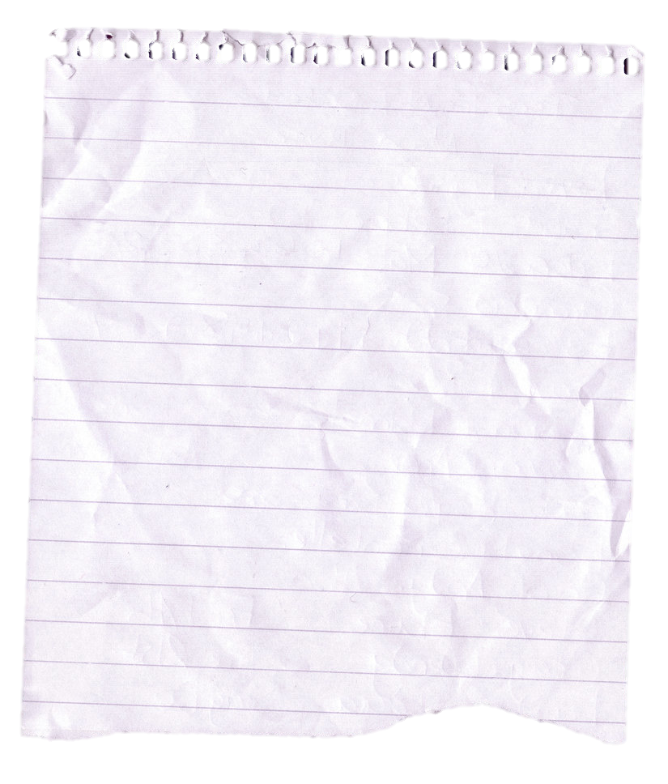

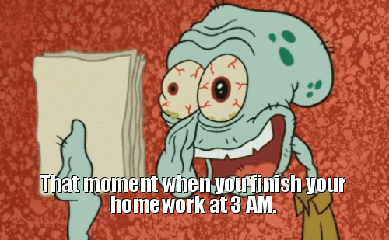
I usually give a homework packet per week that is due on Thursday or Friday. The student may
choose how quickly it is completed.
It is suggested that they work on a
portion each evening.
Science Homework

Slide 11

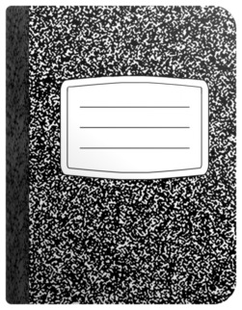
The purpose of an Interactive Student Notebook is to enable your child to be an organized, creative independent thinker.
It is imperative to success in science class that the notebook is in class every day and all information is entered properly. Messy or incomplete note books are not acceptable.
Students will keep their interactive note book in the classroom most of the time.
If they choose to take them home to study, it this their responsibility to bring it back.

Slide 12

As a classroom teacher, it is my duty to create a safe and optimal learning environment for all students. If your child chooses to be disruptive, I will review the expected behavior with them. I will communicate with you should any problems arise so that your student understands you and I are working as a team for their benefit.
GENERAL COURSE OF ACTION:
Problem will be addressed with student; reminded of expected behavior.
Problem will be addressed with student. Parent will be contacted.
Student will serve detention; if problems persist meeting will be held and/or referral written.

Slide 13



Lab safety contracts were sent home to read and for your signature. Extras are at the table in the front.
If students do not take the lab seriously, they are endangering their own safety as well as their classmates.
No horseplay is allowed during lab activities.
If the students do not follow directions properly, they will be removed from the lab and given an alternative assignment for which they will receive no more than a 70.

Slide 14

First Semester Pretest – first week of school
Student Learning Objectives (SLO) This week
First Semester Posttest- December, 2016
Second Semester Pretest- January, 2017
Second Semester Posttest- May, 2017

Slide 15


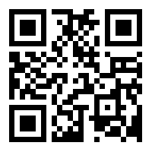
Email: Cheryl.coleman@cobbk12.org (best way) ☺
Phone: 770-819-2414 Ext.1411
I use some social media accounts (professional use only) for class updates. Parents are encouraged to follow!
Website: http://cherylcoleman.weebly.com
Bloomz.com
Twitter feed: @lsgafalcons

Slide 16
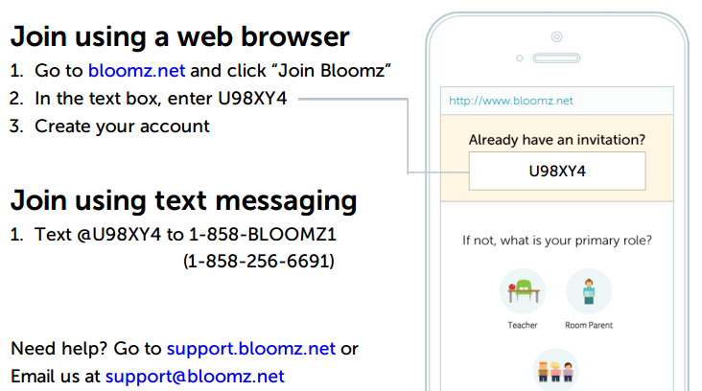
How to set up your Bloomz account if your student is in 1st block
instrucciones en lenguaje de español disponibles

Slide 17
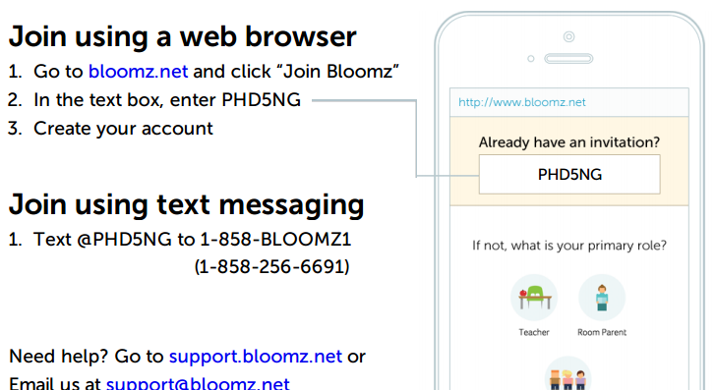
How to set up your Bloomz account if your student is in 3rd block
instrucciones en lenguaje de español disponibles

Slide 18
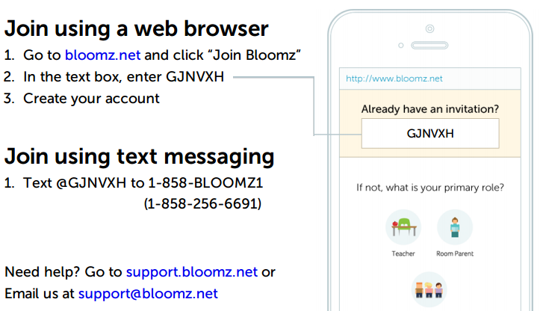
How to set up your Bloomz account if your student is in 4th block
instrucciones en lenguaje de español disponibles

Slide 19
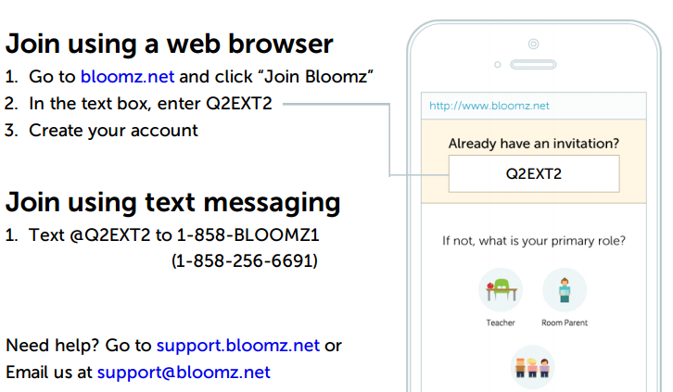
How to set up your Bloomz account if your student is in 5th block
instrucciones en lenguaje de español disponibles

